Slide 1
802 Project Summary
Maksuda Toma, Jo Charbonneau, and Ryan Lalicker

Slide 2
Background & Context
The consumption of beef jerky has been linked to several illnesses and hospitalizations, most of which involving E. Coli or Salmonella. This has lead to several recalls of beef jerky which have been linked to these bacteria.
A study evaluated the effect of two different inoculation methods on Salmonella populations in beef jerky of different thicknesses. The variables involved were:
Salmonella counts
Inoculation methods (dry and wet)
Thickness (¼ inch and ⅛ inch)
Time (weeks 1-5)

Slide 3
Design
2x2 factorial design with two main factors:
Inoculation method (dry vs. wet)
Thickness (¼ & ⅛ inch)
Repeated measures taken over equal time intervals during Weeks 1-5

Slide 4
Model
𝑌_{𝑖𝑗𝑘𝑙} = 𝜇 + 𝛼_{𝑖} + 𝛽_{𝑗} + 𝜏_{𝑘} + (𝛼𝛽)_{𝑖𝑗} + (𝛼𝜏)_{𝑖𝑘} + (𝛽𝜏)_{𝑗𝑘} + (𝛼𝛽𝜏)_{𝑖𝑗𝑘} + 𝑢_{𝑙} + 𝑒_{𝑖𝑗𝑘l}
𝑌_{𝑖𝑗𝑘𝑙}: Salmonella Level
𝜇: overall mean
𝛼_{𝑖} :the effect of the 𝑖th inoculation method
𝛽_{𝑗}: the effect of the 𝑗th thickness level
𝜏_{𝑘}: r the effect of the 𝑘th week
(𝛼𝛽)_{𝑖j}: interaction effect of the 𝑖th inoculation method and the 𝑗th thickness level
(𝛼𝛽𝜏)_{𝑖𝑗𝑘}: three-way interaction between all fixed effects
𝑢_{𝑙}: random effect for batches
𝑒_{𝑖𝑗𝑘l} : residuals

Slide 5
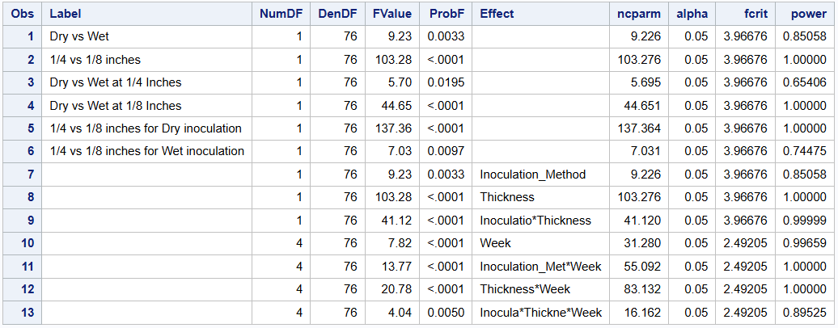
Power Analysis
Orthogonal contrasts between variables:
Difference between inoculation methods (dry and wet)
Difference between thickness (¼ and ⅛ inch)
Generated dataset between five batches, identical response variables across batches. The dataset was then evaluated to determine the power.
Many terms show >80% power, and fixed effects were strong enough to then proceed

Slide 6
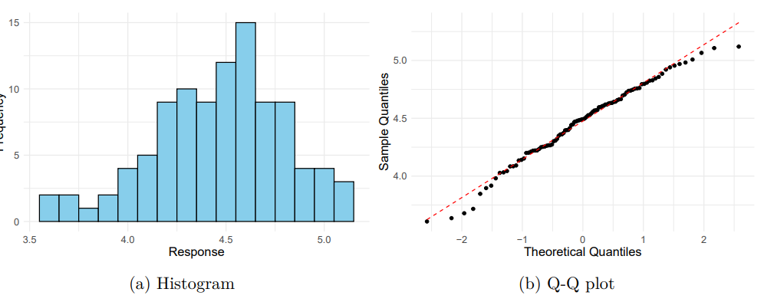
Distribution of Response
Plots to show distribution of response variable:
Histogram indicates a slight skew, but not enough to say the distribution is not normal
Q-Q plot is indicative of a normal distribution

Slide 7
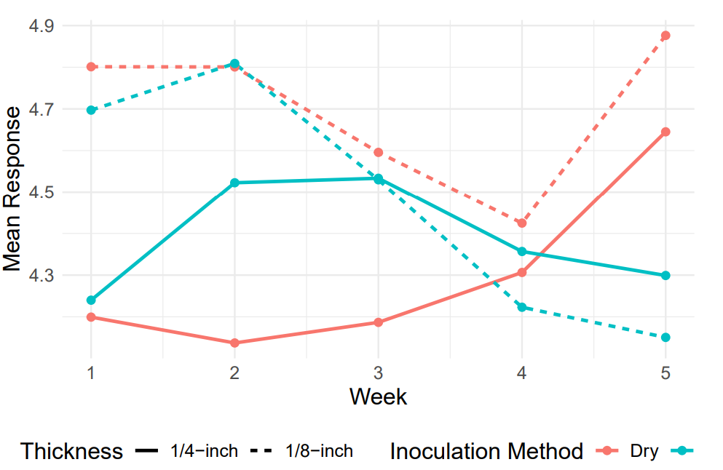
Exploration
Wet inoculation method (blue lines) - mean response tends to decrease over time
Dry Inoculation (red lines) - mean response tends to increase over time
⅛ inch thickness - responses were similar, diverging at the end of the experiment
¼ inch thickness - Showed more variation

Slide 8
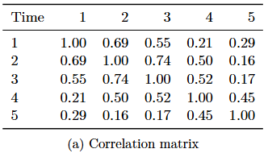
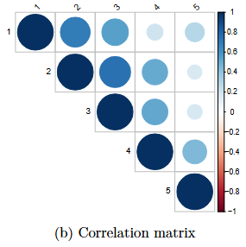
Correlation Over Time
Because this is a repeated measures experiment, we need to account for this variance by selecting a covariance structure.
Plan to use AR(1) structure
Suited for equally spaced, ordered data over time
Strong correlations observed between adjacent weeks
Week 1 vs. Week 2 (r = 0.69)
Week 2 vs. Week 3 (r = 0.74)
Correlations weaken as time gap increases

Slide 9
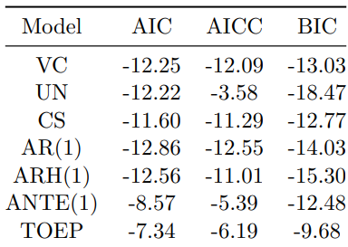
Model Comparison
While confident in AR(1), we also tested other covariance structures for comparison.
From the model comparison:
AR(1) structure is the best fit with the lowest AIC and AICC, and a respectable BIC score
In verifying model assumptions, we must check that residuals are normally distributed and homogeneous

Slide 10
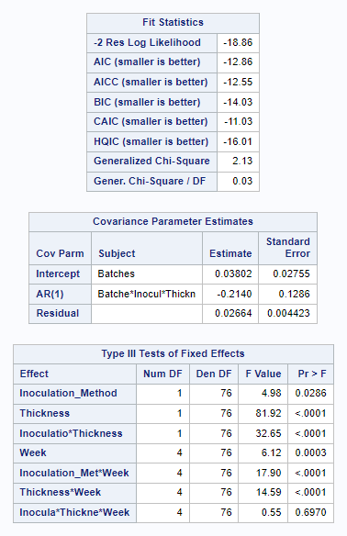
Model Results
The model successfully converged, with variance estimates for random intercepts (batches: 0.03802) and residuals (0.02064). suggest that the model fits the data reasonably well, indicating minimal unexplained variability, and the SE (0.004423) confirming the reliability of this estimate.
The AR(1) autocorrelation (-0.2140) indicates weak negative correlation between adjacent time points.
Inoculation Method (𝑝=0.0286), Thickness (𝑝 <0.0001), and Week (𝑝=0.0216) significantly influence the response, highlighting key factors affecting the outcome.
Significant interactions include Inoculation Method*Thickness (𝑝<0.0001) and Thickness*Week (𝑝=0.0006), while Inoculation Method*Week (𝑝=0.1529) and the three-way interaction (𝑝=0.6970p) are not significant.

Slide 11
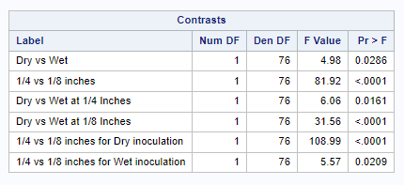
Contrast Result
Both inoculation method and thickness significantly influence the outcome, and their effects depend on their combinations. The most notable differences are observed in the contrast between 1/4-inch and 1/8-inch thickness for the Dry inoculation method.
This indicates that Salmonella bacteria grows more in dry jerky, particularly at 1/8-inch thickness, where bacterial growth is significantly higher than in wet jerky or thicker samples.
This highlights that the Dry inoculation method and thinner jerky provide more favorable conditions for bacterial growth.

Slide 12
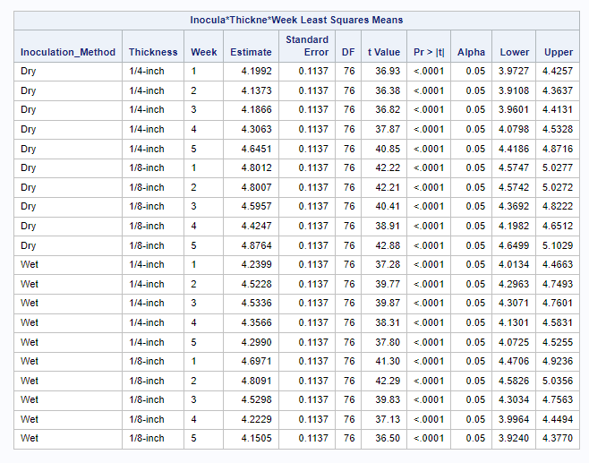
Model Results
LSMeans Overview:
The table shows the estimated response for combinations of Inoculation Method, Thickness, and Week, with all combinations being highly significant (𝑝<0.0001) and confidence intervals confirming reliability
Trends:
For 1/4-inch thickness, both Dry and Wet methods show increases over time, with Dry typically having higher responses. For 1/8-inch thickness, the differences between Dry and Wet are smaller but still notable.

Slide 13
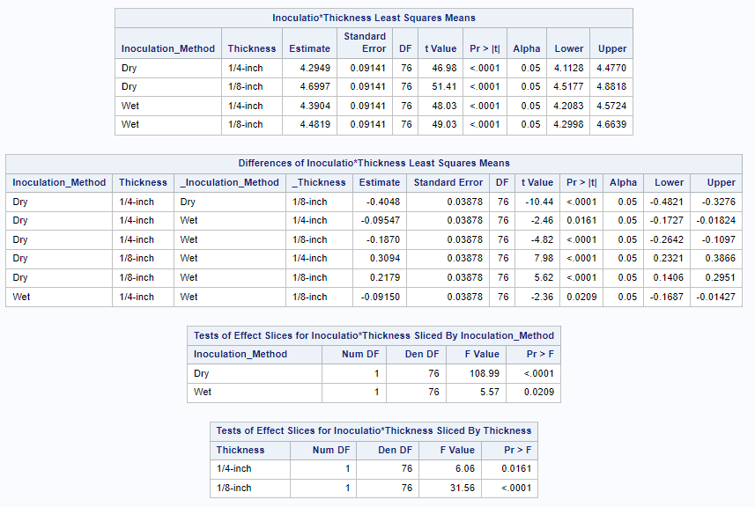
Model Results- “Method*Thickness
Both inoculation method (Dry or Wet) and thickness (1/4-inch or 1/8-inch) significantly affect the outcome, with 1/8-inch consistently leading to higher responses than 1/4-inch (𝑝<0.0001).
Significant differences are observed between Dry and Wet methods, with Wet generally performing better at 1/4-inch thickness and more noticeable differences at 1/8-inch thickness.

Slide 14
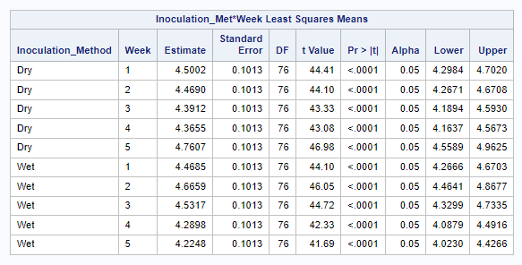
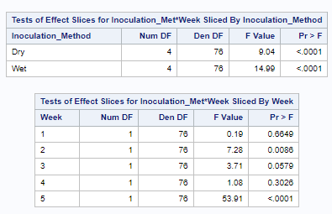
Model Results- “Method*Week”
The interaction between inoculation method and time (Week) is evident, with Dry inoculation showing an increase in Week 5 and Wet inoculation peaking earlier. This indicates that the timing of bacterial growth depends on the inoculation method used.
The interaction between Inoculation Method and Week is significant, with differences in bacterial growth patterns being particularly pronounced for Week 5, where the Dry method shows significantly higher responses than Wet. This suggests the impact of inoculation method depends on the week of measurement.

Slide 15
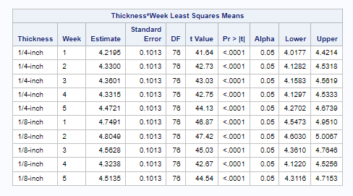
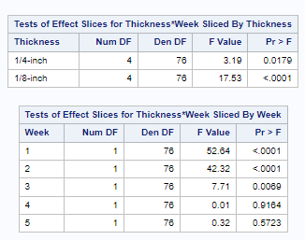
Model Results- “Thickness*Week”
The 1/8-inch thickness facilitates higher bacterial growth compared to 1/4-inch across all weeks, with Week 2 showing the highest LSMean for 1/8-inch. This highlights that the combination of thinner slices and Week 2 conditions create the most favorable environment for bacterial growth.
The 1/8-inch thickness shows greater variability in bacterial growth across weeks, highlighting its susceptibility. Thickness differences are most significant in Weeks 1 and 2, where thinner slices (1/8-inch) show much higher bacterial growth than thicker slices (1/4-inch). By Week 5, the effect of thickness diminishes, suggesting bacterial growth stabilizes between the two thicknesses.

Slide 16
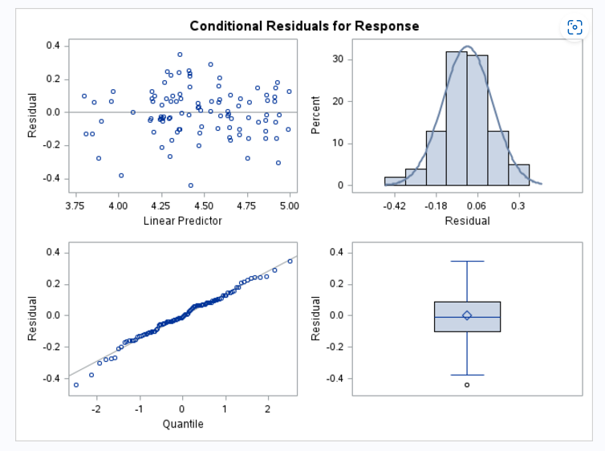
Model Result- Assumption Checking
The histogram and Q-Q plot indicate that residuals are approximately normal, supporting the normality assumption
The residual plot shows no clear pattern, suggesting that the assumption of constant variance (homoscedasticity) holds
The boxplot shows one potential outlier, but it does not significantly impact normality
Overall, residual diagnostics confirm that key assumptions of the model are satisfied.

Slide 17
Summary

Slide 18
Recommendation
Since bacteria growth is stronger in dry and thick beef jerky, to lessen the bacteria effect, the client might emphasize on making wet and less thin jerky.
To reduce bacterial growth, focus on critical weeks: prioritize monitoring Week 2 and Week 5 for inoculation methods, as these show significant differences between Dry and Wet, and Week 1 and Week 2 for thickness, as 1/8-inch slices are more prone to bacterial growth.
Use thicker slices (1/4-inch) to minimize bacterial growth and ensure uniform thickness during processing
Prioritize the Wet inoculation method over Dry, as it consistently results in lower bacterial growth, especially during the critical weeks

Slide 19
Citations
Bobbit, Zach. 2021. “How to Interpret Negative AIC Values.” Statology. 2021.https://www.statology.org/negative-aic/.
Brown, Jessica, Taylor Bannon, Arie Havelaar, Chad Carr, Barbara B. Kowalcyk, and JasonM. Scheffler. 2024. “Inactivation of Salmonella Enterica, Escherichia Coli O157:H7, andCampylobacter Jejuni in a Restructured Beef Jerky Developed for Production in Ethiopia.”Meat and Muscle Biology8 (April): 1–12.https://doi.org/10.22175/mmb.16091.
Lipka, Alex, and Benjamin Tyner. 2004. “Repeated Measures Covariance Structure.” Sta-tistical Consulting Service - Purdue University. 2004.https://www.stat.purdue.edu/scs/help/method/Repeated%20measures%20analysis.pdf.
USDA. n.d. “Appendix e: Selecting an Appropriate Covariance Structure,” n.d., E.1–8.https://www.ars.usda.gov/ARSUserFiles/80000000/StatisticsGroupWebinars/Appendix%20E%20-%20Selecting%20a%20Covariance%20Structure.pdf.11

